Slide 1
Illumination Models & Surface-Rendering Methods

Slide 2
Illumination Models & Surface-Rendering Methods
Illumination model or a lighting model is the model for calculating light intensity at a single surface point.
Rendering is the process of generating an image from a 2D or 3D model by means of computer programs
Surface rendering is a procedure for applying a lighting model to obtain pixel intensities for all the projected surface positions in a scene.

Slide 3
Lighting - the process of computing the luminous intensity reflected from a specified 3-D point
Shading - the process of assigning a colors to a pixels

Slide 4
Surface rendering
Surface rendering can be performed by applying the illumination model to every visible surface point, or the rendering can be accomplished by interpolating intensities across the surface from a small set of illumination-model calculations.
Scan-line algorithms use interpolation schemes.
Ray tracing algorithms invoke the illumination model at each pixel position.
Surface-rendering procedures are termed surface-shading methods.

Slide 5
Illumination models
Given the parameters:
the optical properties of surfaces (opaque/transparent, shiny/dull, surface-texture);
the relative positions of the surfaces in a scene;
the color and positions of the light sources;
the position and orientation of the viewing plane.
Illumination models calculate the intensity projected from a particular surface point in a specified viewing direction.
Notes:
To minimize intensity calculations, most packages use empirical models based on simplified photometric calculations.

Slide 6
Light Sources
When we view an opaque (nontransparent) nonluminous object, we see reflected light from the surfaces of the object.
The total reflected light is the sum of the contributions from light sources and other reflecting surfaces in the scene.
Light sources = light-emitting sources.
Reflecting surfaces = light-reflecting sources.

Slide 7
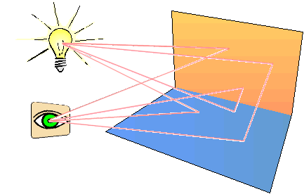
Light Sources
Light
Source
Reflecting
Surfaces
Fig. 1
Light viewed from an opaque surface is in general a combination of reflected light from a light source and reflections of light reflections from other surfaces.

Slide 8
Point Light Source
The rays emitted from a point
light radially diverge from the
source.
Approximation for sources
that are small compared to
the size of objects in the scene.
A point light source is a fair approximation to a local light source such as a light bulb.
The direction of the light to each point on a surface changes when a point light source is used.
Fig. 2
Diverging ray paths from a point light source.

Slide 9
Distributed Light Source
A nearby source, such as
the long fluorescent light.
All of the rays from a
directional/distributed
light source have the
same direction, and no
point of origin.
It is as if the light source was infinitely far away from the surface that it is illuminating(bright).
Sunlight is an example of an infinite light source.
Fig. 3
An object illuminated with a distributed light source.

Slide 10
Materials
When light is incident on an opaque surface, part of it is reflected and part is absorbed.
Shiny materials reflect more of the incident light, and dull surface absorb more of the incident light.
For an illuminated transparent surface, some of the incident light will be reflected and some will be transmitted through the material.

Slide 11
Diffuse reflection
Grainy surfaces scatter the reflected light in all directions. This scattered light is called diffuse reflection.
Diffuse reflection occurs from dull, matte surfaces, like latex paint, or chalk. These diffuse reflectors reradiate light equally in all directions. Picture a rough surface with lots of tiny micro facets.
Diffuse reflections are constant over each surface in the scene, independent of the viewing direction.
Fig. 4
Diffuse reflection from a surface.

Slide 12
Specular reflection
Light sources create highlights, bright spots, called specular reflection. More pronounced on shiny surfaces than on dull.
Fig. 5
Specular reflection superimposed on diffuse reflection vectors.

Slide 13
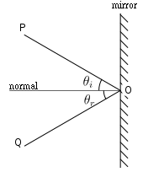
Specular reflection
is the mirror-like reflection of light (or of other kinds of wave) from a surface, in which light from a single incoming direction (a ray) is reflected into a single outgoing direction. Such behavior is described by the law of reflection, which states that the direction of incoming light (the incident ray), and the direction of outgoing light reflected (the reflected ray) make the same angle with respect to the surface normal, thus the angle of incidence equals the angle of reflection and that the incident, normal, and reflected directions are coplanar.

Slide 14
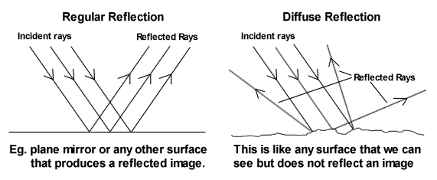

Slide 15
Lighting calculations are based on:
Optical properties of surfaces, such as glossy, matte, opaque, and transparent. This controls the amount of reflection and absorption of incident light.
The background lighting conditions.
The light-source specifications. All light sources are considered to be point sources, specified with a coordinate position and intensity value (color).

Slide 16
Ambient Light
The lights are coming from different sources.
Ambient light is the light that exists in a scene. Also referred to as “natural light” or “existing light,” ambient light can be the found light inside a home, a restaurant or concert hall, or a bright, sunny day, a deep foggy day, a city at night… in other words, any kind of pre-existing light. This is found light, not additional light that you, the photographer, might choose to add, such as flash

Slide 17
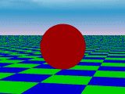
Ambient Light
Even though an object in a scene
is not directly lit it will still be
visible. This is because light is
reflected from nearby objects.
Ambient light has no spatial or
directional characteristics.
The amount of ambient light incident on each object is a constant for all surfaces and over all directions.
The amount of ambient light that is reflected by an object is independent of the objects position or orientation and depends only on the optical properties of the surface.
Fig. 6
Ambient light shading.

Slide 18
In photography and cinematography, available light or ambient light refers to any source of light that is not explicitly supplied by the photographer for the purpose of taking photos.
The term usually refers to sources of light that are already available naturally (e.g. the sun, moon, lightning) or artificial light already being used (e.g. to light a room).It generally excludes flashes, although arguably flash lighting provided by other photographers shooting simultaneously in the same space could be considered available light.
Light sources that affect the scene and are included in the actual frame are called practical light sources, or simply practicals

Slide 19
Use of available light is an important factor in candid photography in order not to disturb the subjects.
The use of available light may pose a challenge for a photographer.
The brightness and direction of the light is often not adjustable, except perhaps for indoor lighting. This will limit the selection of shutter speeds, and may require the use of shades or reflectors to manipulate the light.
It can also influence the time, location, and even orientation of the photo shoot to obtain the desired lighting conditions. Available light can often also produce a color cast with color photography.

Slide 20
Ambient Light
The level of ambient light in a scene is a parameter I_{a} , and each surface illuminated with this constant value.
Illumination equation for ambient light is
I = k_{a}I_{a}
where
I is the resulting intensity
I_{a} is the incident ambient light intensity
k_{a} is the object’s basic intensity, ambient-
reflection coefficient.

Slide 21
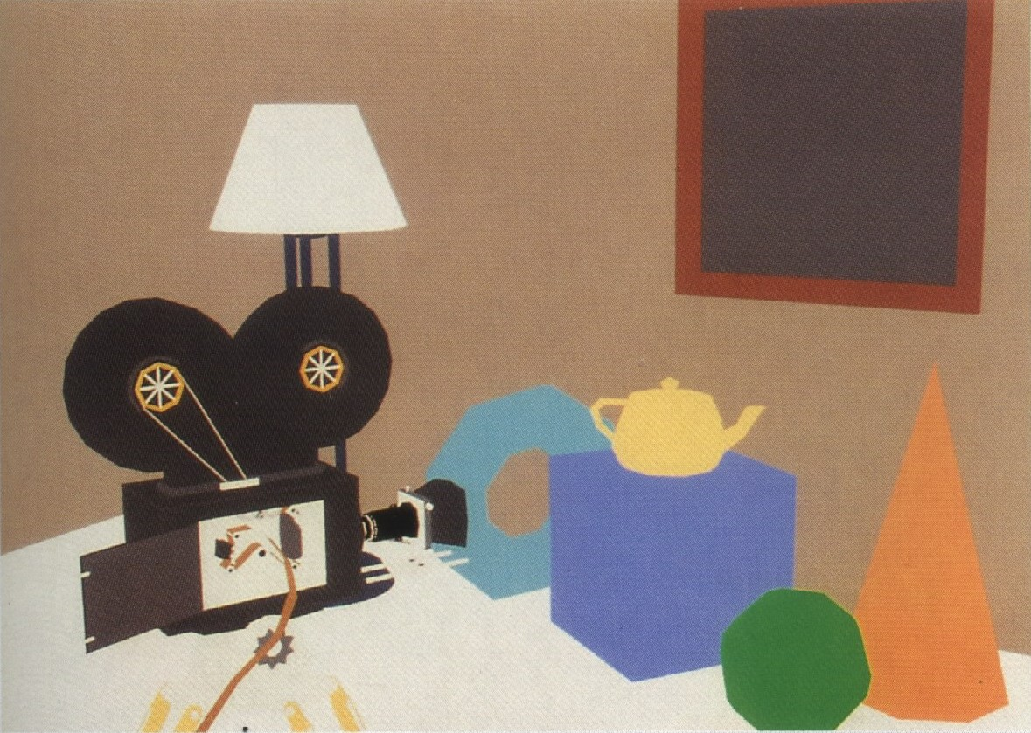
Ambient Light - Example
Fig. 7
An ambient illumination only.
Notes:
Since ambient light produces a flat shading for each surface (Fig. 6 and 7), at least one light source is included in a scene, often as a point source at the viewing position.

Slide 22
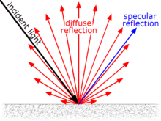
Diffuse reflection
Diffuse reflection is the reflection of light from a surface such that an incident ray is reflected at many angles rather than at just one angle as in the case of specular reflection. An illuminated ideal diffuse reflecting surface will have equal luminance from all directions which lie in the half-space adjacent to the surface

Slide 23
Diffuse Reflection
Diffuse reflections are constant over each surface in a scene, independent of the viewing direction.
The amount of the incident light that is diffusely reflected can be set for each surface with parameter k_{d}, the diffuse-reflection coefficient, or diffuse reflectivity.
0 ≤ k_{d} ≤ 1;
k_{d} near 1 – highly reflective surface;
k_{d} near 0 – surface that absorbs most of the
incident light;
k_{d} is a function of surface color;

Slide 24
Diffuse Reflection
Even though there is equal light scattering in all direction
from a surface, the brightness of the surface does depend
on the orientation of the surface relative to the light
source:
(a)
(b)
Fig. 8
A surface perpendicular to the direction of the incident light (a) is more illuminated than an equal-sized surface at an oblique angle (b) to the incoming light direction.

Slide 25
Diffuse Reflection
As the angle between the surface normal and the incoming light direction increases, les of the incident light falls on the surface.
We denote the angle of incidence between the incoming light direction and the surface normal as θ. Thus, the amount of illumination depends on cosθ. If the incoming light from the source is perpendicular to the surface at a particular point, that point is fully illuminated.

Slide 26
Diffuse Reflection
If I_{l} is the intensity of the point
Light source, then the diffuse
reflection equation for a point
on the surface can be written as
I_{l,diff} = k_{d}I_{l}cosθ
or
I_{l,diff} = k_{d}I_{l}(N.L)
where
N is the unit normal vector to a surface and L is the
unit direction vector to the point light source from a
position on the surface.
N
To Light Source
L
θ
Fig. 9
Angle of incidenceθ between the unit light-source
direction vector L and the unit surface normal N.

Slide 27
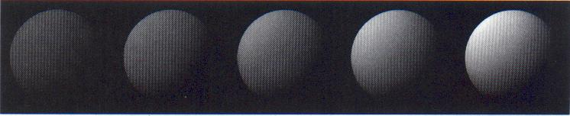
Diffuse Reflection
Figure 10 illustrates the illumination with
diffuse reflection, using various values of
parameter k_{d} between 0 and1.
Fig. 10
Series of pictures of sphere illuminated by diffuse reflection model only using different k_{d} values (0.4, 0.55, 0.7, 0.85,1.0).

Slide 28
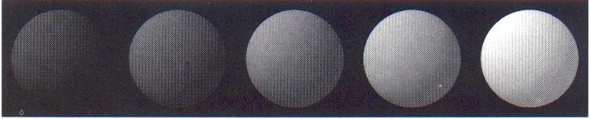
Diffuse Reflection
We can combine the ambient and point-source
intensity calculations to obtain an expression for the
total diffuse reflection.
I_{diff} = k_{a}I_{a}+k_{d}I_{l}(N.L)
where both k_{a} and k_{d} depend on surface material
properties and are assigned values in the range from
0 to 1.
Fig. 11
Series of pictures of sphere illuminated by ambient and diffuse reflection model.
I_{a} = I_{l} = 1.0, k_{d} = 0.4 and k_{a} values (0.0, 0.15, 0.30, 0.45, 0.60).

Slide 29
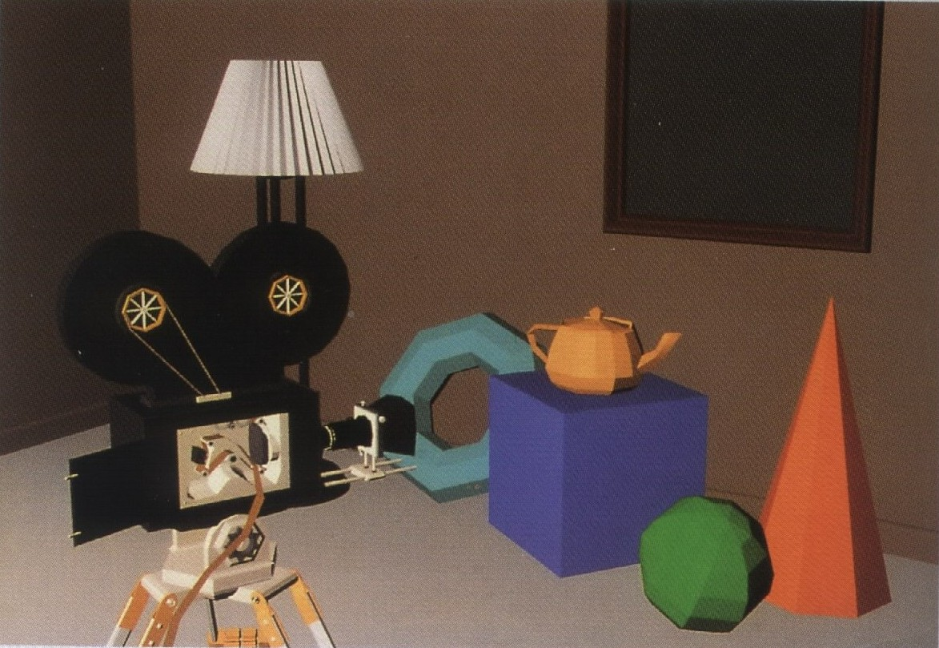
Diffuse Reflection - Example
Fig. 12
Individually shaded polygons with diffuse reflection.

Slide 30
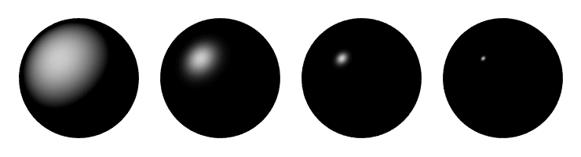
Specular Reflection and the Phong Model
Specular reflection is the result of total, or near total, reflection of the incident light in a concentrated region around the specular-reflection angle.
Shiny surfaces have a narrow specular-reflection range.
Dull surfaces have a wider reflection range.

Slide 31
Specular Reflection
Figure 13 shows the specular reflection
direction at a point on the
illuminated surface. In this figure,
R represents the unit vector in
the direction of specular reflection;
L – unit vector directed toward the
point light source;
V – unit vector pointing to the viewer from the surface position;
Angle Φ is the viewing angle relative to the specular-reflection direction R.
N
To Light Source
R
L
θ
θ
Φ
V
Fig. 13
Modeling specular reflection.

Slide 32
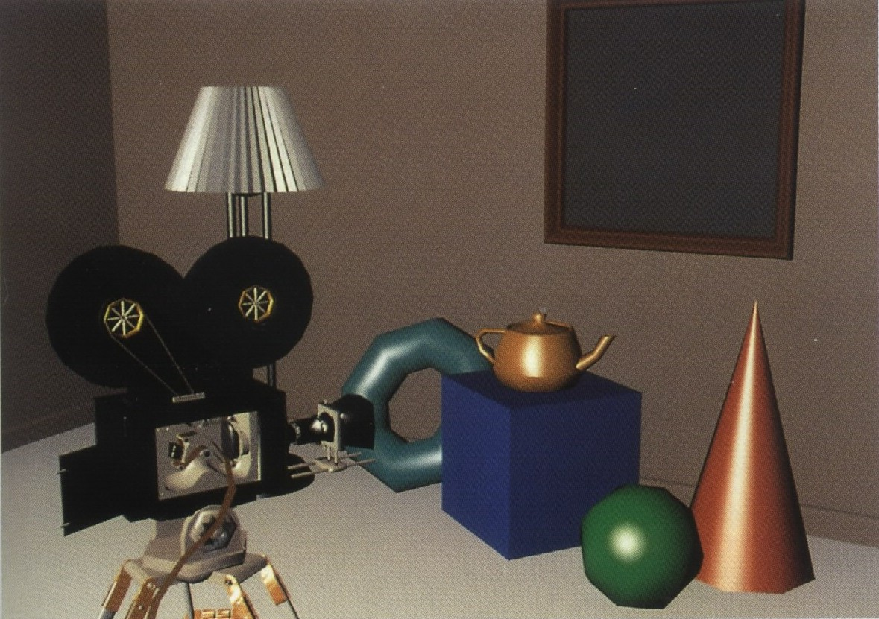
Specular Reflection - Example
Fig. 18
Phong shading polygons with specular reflection.

Slide 33
Combine Diffuse & Specular Reflections
For a single point light source, we can model
the combined diffuse and specular reflections
from a point on an illuminated surface as
I = I_{diff} + I_{spec}
= k_{a}I_{a} + k_{d}I_{l}(N.L) + k_{s}I_{l}(N.H)^{ns}

Slide 34
Combine Diffuse & Specular Reflections with Multiple Light Sources
If we place more than one point source in a
scene, we obtain the light reflection at any
surface point by summering the contributions
from the individual sources:
I = k_{a}I_{a} + Σ^{n}_{i=1} I_{li} [k_{d} (N.L_{i}) + k_{s}(N.H_{i})^{ns}]

Slide 35
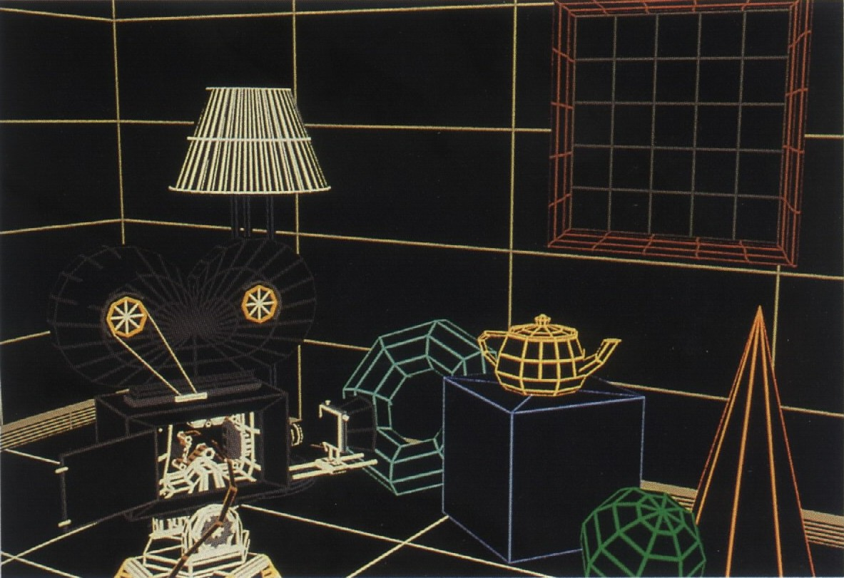
Visible-line determination

Slide 36
Visible-surface determination with ambient illumination only

Slide 37
Individually shaded polygons with diffuse reflection

Slide 38
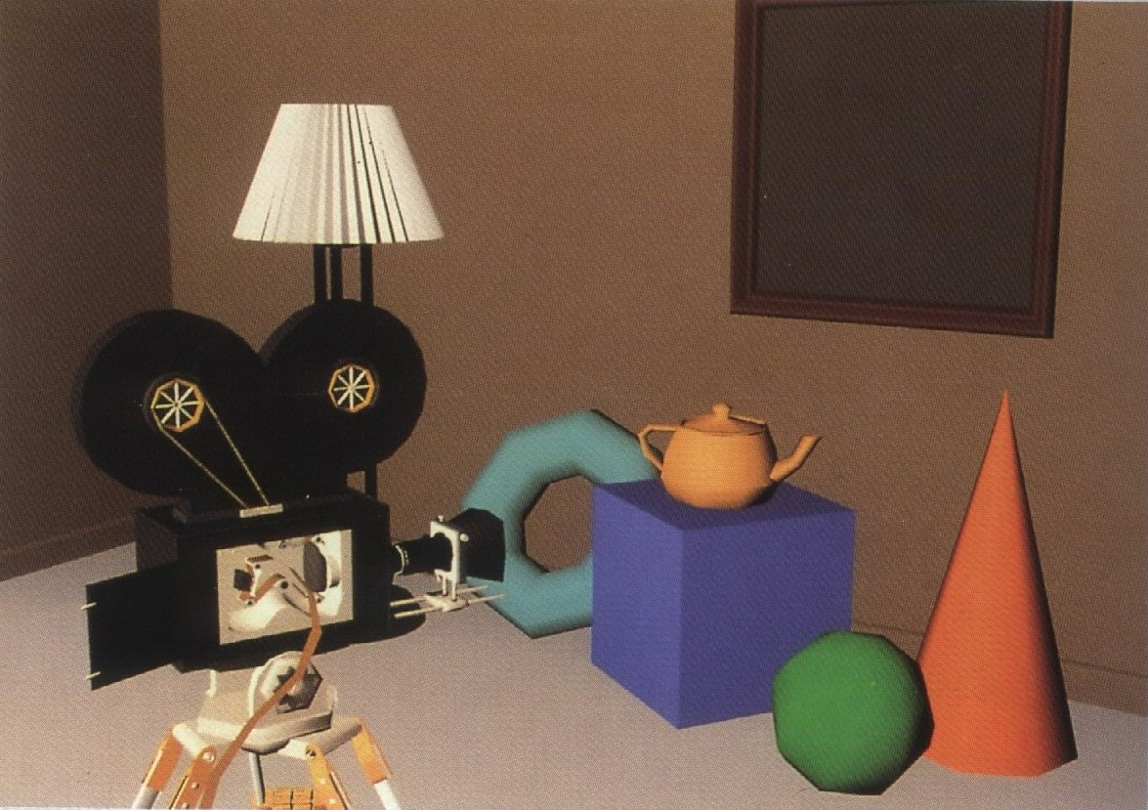
Gouraud shaded polygons with diffuse reflection

Slide 39
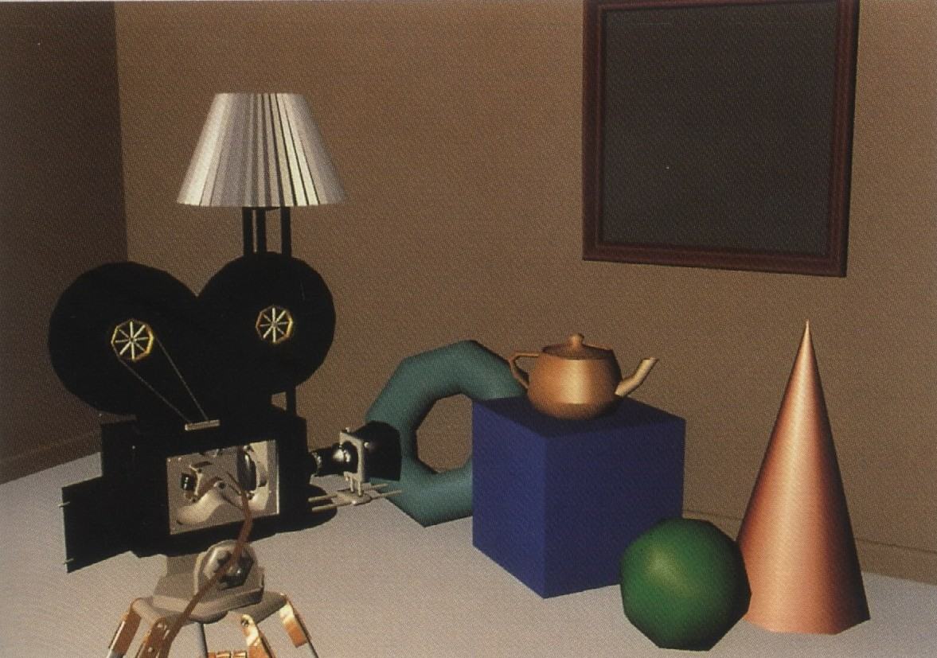
Gouraud shaded polygons with specular reflection

Slide 40
Phong shaded polygons with specular reflection

Slide 41
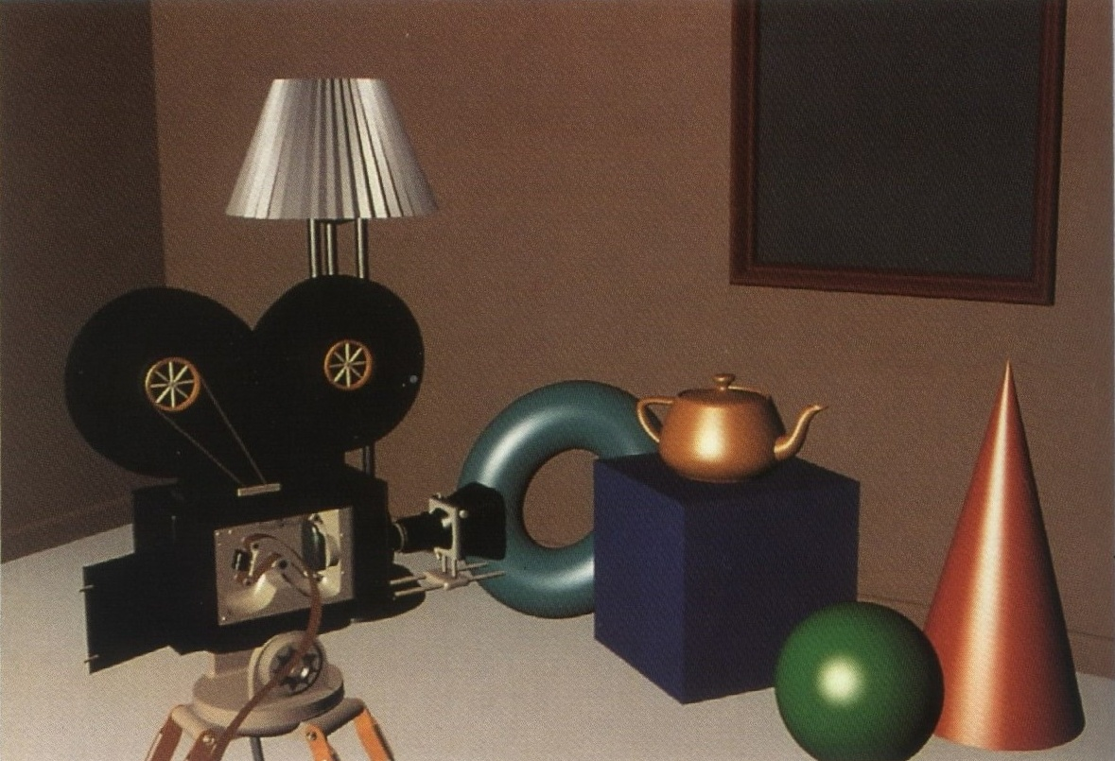
Curved surfaces with specular reflection

Slide 42
Polygon rendering methods
Here we consider the application of an illumination model to the rendering of standard graphics objects those formed with polygon surfaces.
Polygon Shading Algorithms
Wireframe
Flat
Gouraud
phong

Slide 43
Wireframe
A wire-frame model is a visual presentation of a 3-dimensional (3D) or physical object used in 3D computer graphics. It is created by specifying each edge of the physical object where two mathematically continuous smooth surfaces meet, or by connecting an object's constituent vertices using straight lines or curves.
The object is projected into screen space by drawing lines at the location of each edge. The term wire frame comes from designers using metal wire to represent the three-dimensional shape of solid objects. 3D wire frame allows to construct and manipulate solids and solid surfaces. The 3D solid modeling technique efficiently draws higher quality representations of solids than the conventional line drawing.

Slide 44
Using a wire-frame model allows visualization of the underlying design structure of a 3D model.
Traditional two-dimensional views and drawings can be created by appropriate rotation of the object and selection of hidden line removal via cutting planes.
Since wire-frame renderings are relatively simple and fast to calculate, they are often used in cases where a high screen frame rate is needed.
This allows the designer to quickly review solids or rotate the object to new desired views without long delays associated with more realistic rendering.

Slide 45
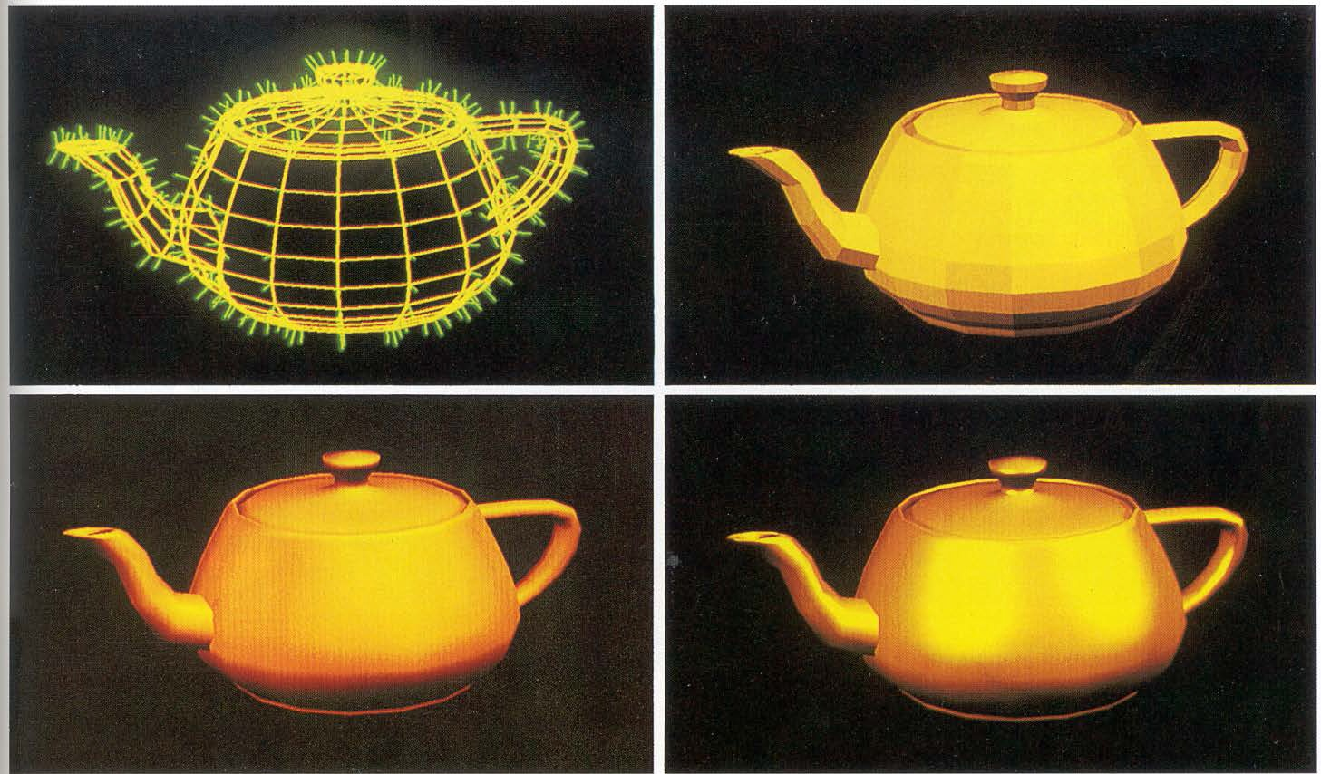

Slide 46
Shading
“ Shading is referred as the implementation of illumination model at the pixel points or polygon surfaces of the graphics objects.”

Slide 47
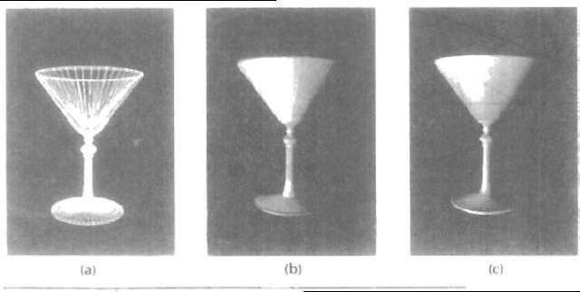
Flat Shading
A fast and simple method for rendering an object with polygon surfaces is constant intensity shading, also called flat shading.
In this method, a single intensity is calculated for each polygon All points over the surface of the polygon are then displayed with the same intensity value.
Constant shading can be useful for quickly displaying the general appearance of a curved surface, as in Fig

Slide 48
Fig(1). A polygon mesh approximation of an object (a) is rendered with flat shading (b) and With Gouraud shading (c).
In general, flat shading of polygon facets provides an accurate rendering for an object if all of the following assumptions are valid: -
1. The object is a polyhedron and is not an approximation of an object with a curved surface.
2. All light sources illuminating the objects are sufficiently far from the surface so that N . L and the attenuation function are constant over the surface(where N is the unit normal to a surface and L is the unit direction vector to the point light source from a position on the surface).

Slide 49
3. The viewing position is sufficiently far from the surface so that V .R is constant over the surface.(where V is the unit vector pointing to the viewer from the surface position and R represent unit vector in the direction of ideal specular reflection).

Slide 50
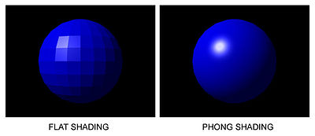
: If there happens to be a large specular component at the representative vertex, that brightness is drawn uniformly over the entire face. If a specular highlight doesn’t fall on the representative point, it is missed entirely. Consequently, the specular reflection component is usually not included in flat shading computation.

Slide 51
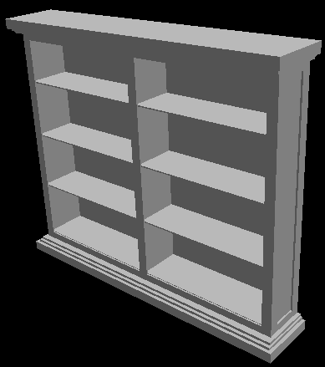

Slide 52
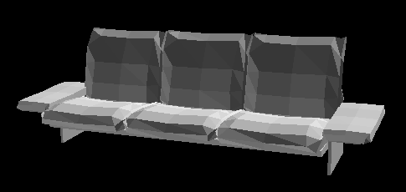
Objects look like they are composed of polygons
OK for polyhedral objects
Not so good for ones with smooth surfaces

Slide 53
Smooth Shading
In contrast to flat shading with smooth shading the color changes from pixel to pixel. It assumes that the surfaces are curved and uses interpolation techniques to calculate the values of pixels between the vertices of the polygons.
Types of smooth shading include:
phong Shading
Gouraud Shading

Slide 54
Gouraud Shading
This intensity-interpolation scheme, developed by Gouraud and generally referred to as Gouraud shading, renders a polygon surface by linearly interpolating intensity values across the surface.
Intensity values for each polygon are matched with the values of adjacent polygons along the common edges, thus eliminating the intensity discontinuities that can occur in flat shading.
Each polygon surface is rendered with Gouraud shading by performing the following calculations:
1. Determine the average unit normal vector at each polygon vertex.
2. Apply an illumination model to each vertex to calculate the vertex intensity.
3. Linearly interpolate the vertex intensities over the surface of the polygon.

Slide 55
Advantages
Polygons, more complex than triangles, can also have different colors specified for each vertex. In these instances, the underlying logic for shading can become more intricate.
Problems
Even the smoothness introduced by Gouraud shading may not prevent the appearance of the shading differences between adjacent polygons.
Gouraud shading is more CPU intensive and can become a problem when rendering real time environments with many polygons.
T-Junctions with adjoining polygons can sometimes result in visual anomalies. In general, T-Junctions should be avoided.

Slide 56
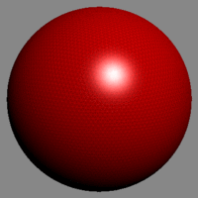

Slide 57
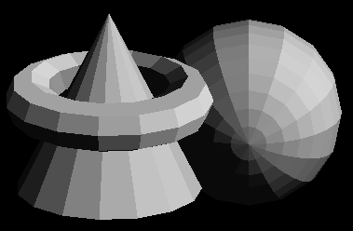
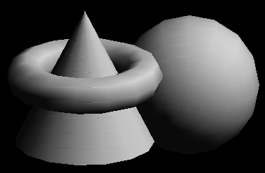
Polygon Smooth Shading

Slide 58
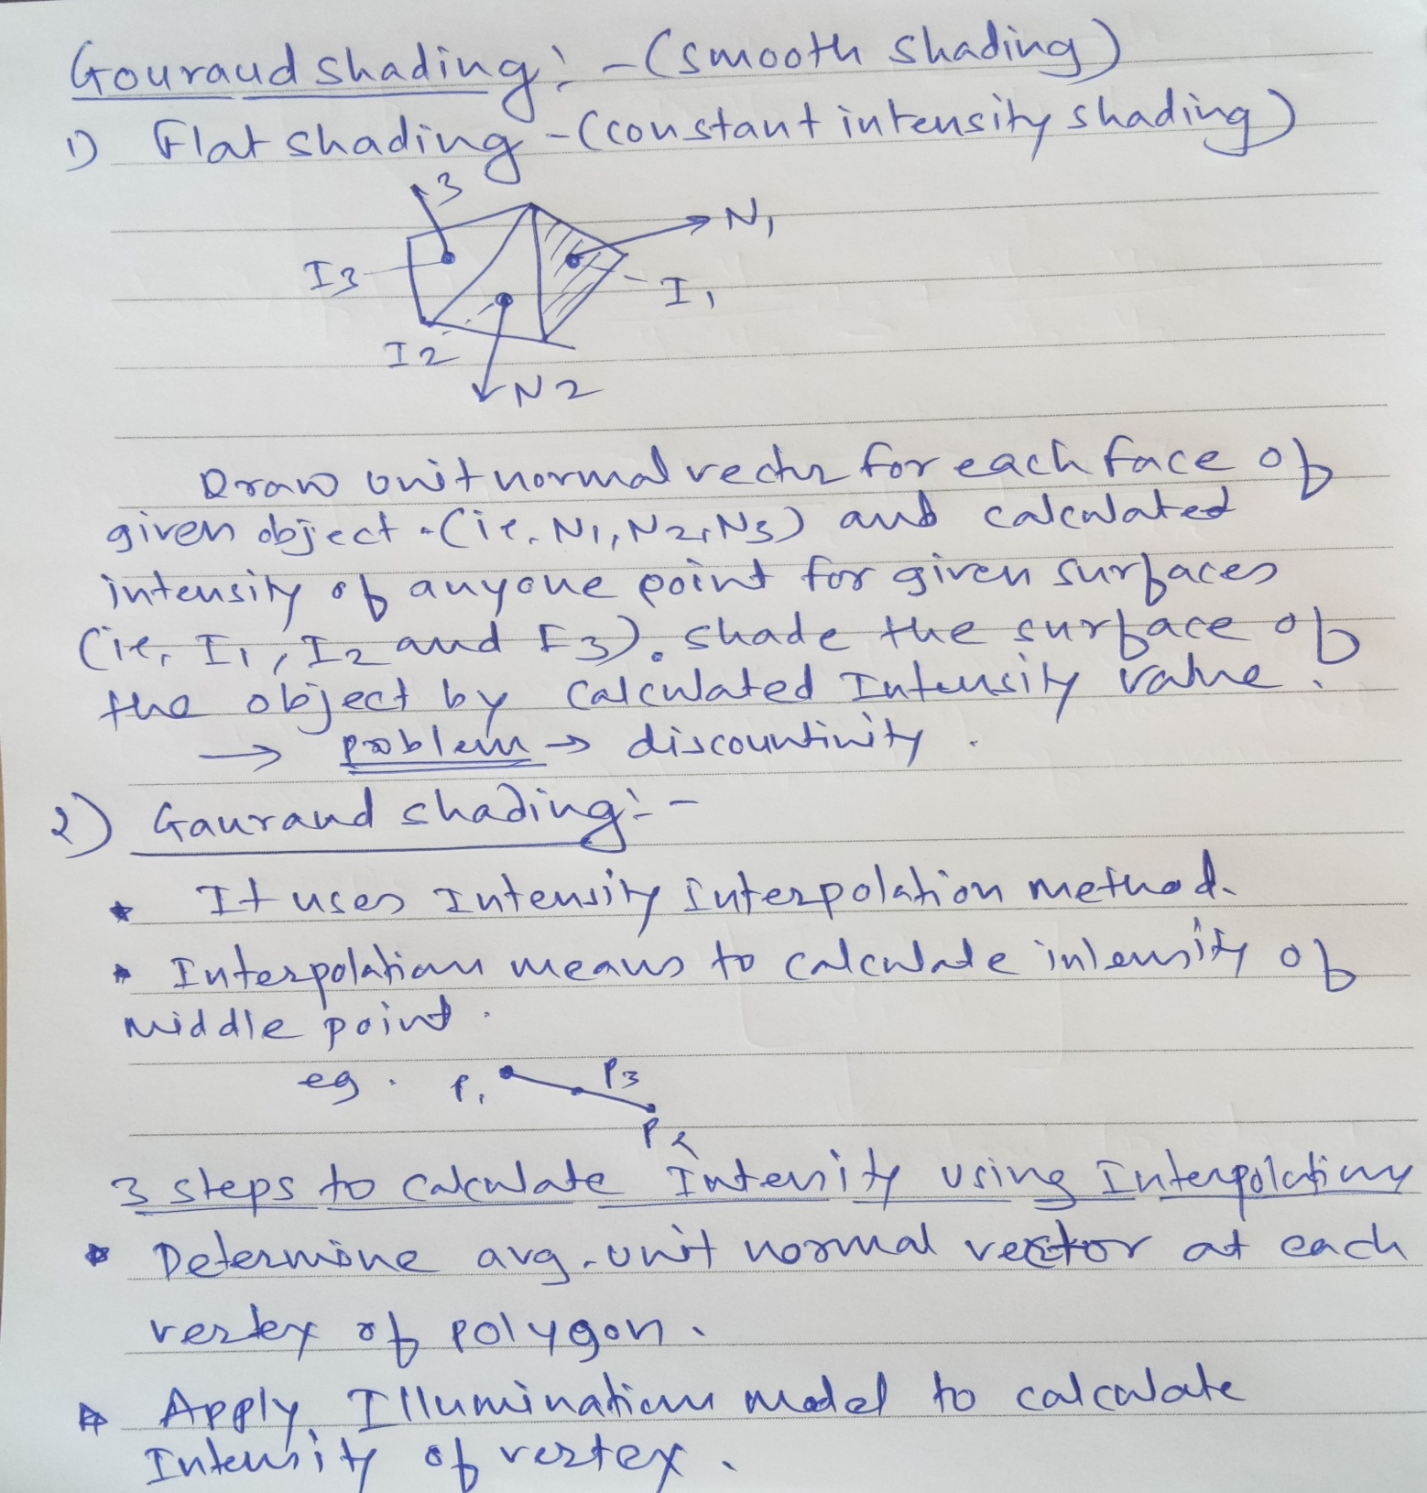

Slide 59
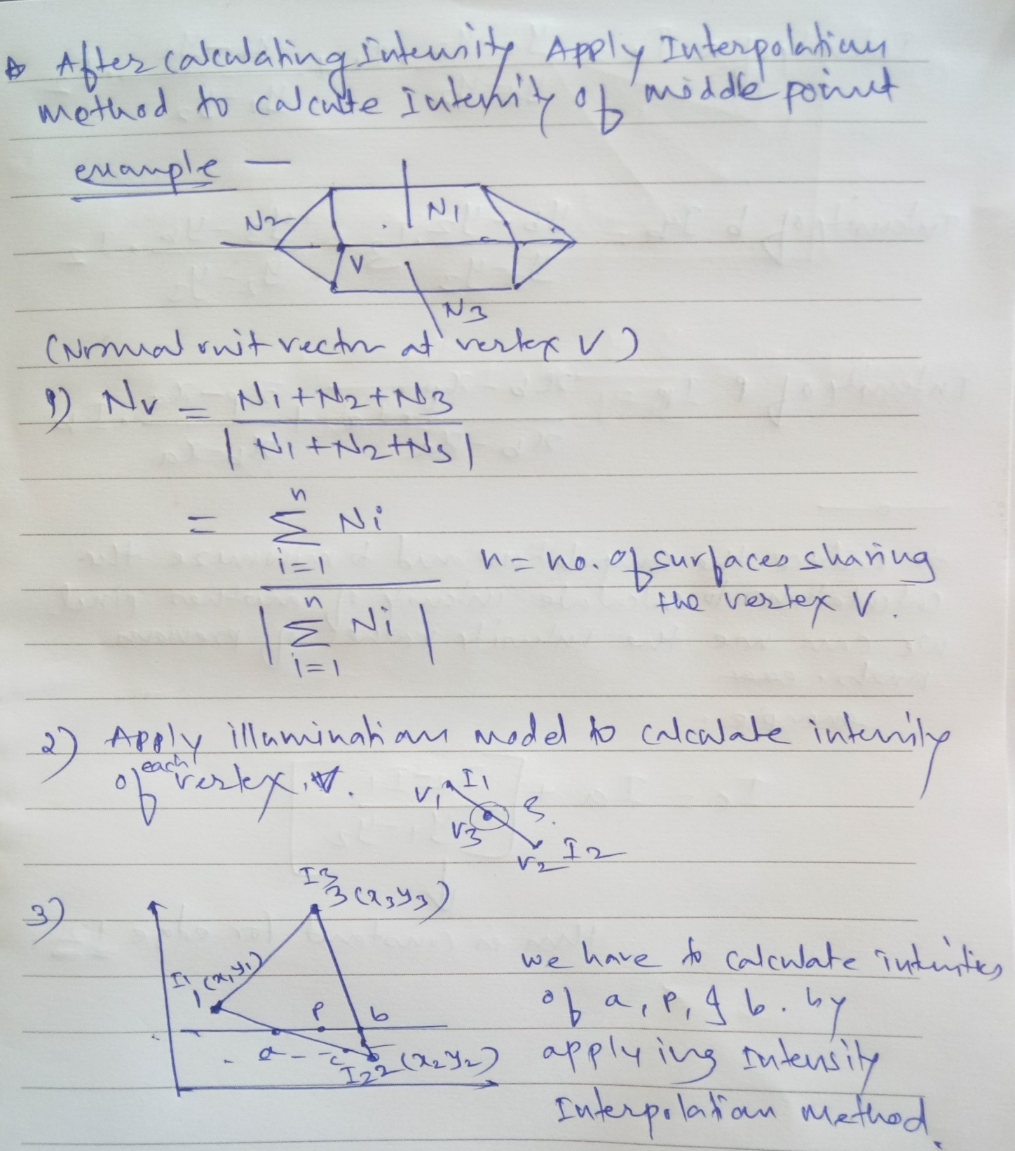

Slide 60
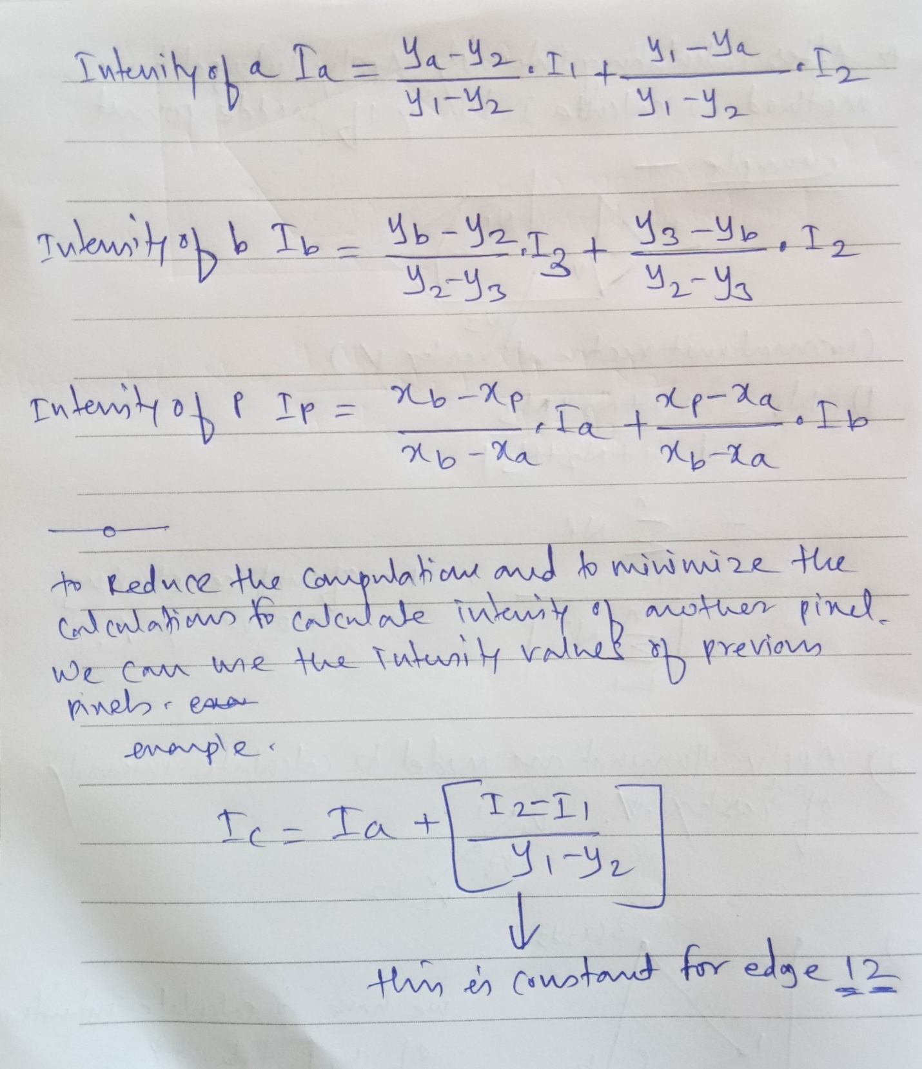

Slide 61
Phong shading
A more accurate method for rendering a polygon surfacevis to interpolate normal vectors, and then apply the illumination model to each surface point. This method, developed by Phong Bu Tuong, is called Phong shading, or normal vector interpolation shading.
It displays more realistic highlights on a surface and greatly reduces the Mach-band effect. A polygon surface is rendered using Phong shading by carrying out the following steps:
1. Determine the average unit normal vector at each polygon
vertex.
2. Linearly & interpolate the vertex normals over the surface of the polygon.
3. Apply an illumination model along each scan line to calculate projected pixel intensities for the surface points.

Slide 62
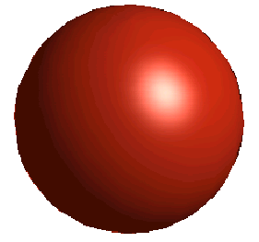
Phong Shading
A more accurate method for rendering a polygon surface is to interpolate normal vectors, and then apply the illumination model to each surface point.

Slide 63
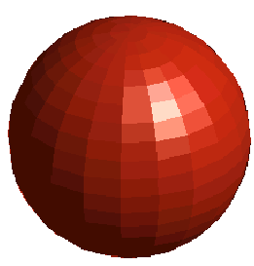
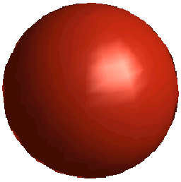
Flat
Gouraud
Phong

Slide 64
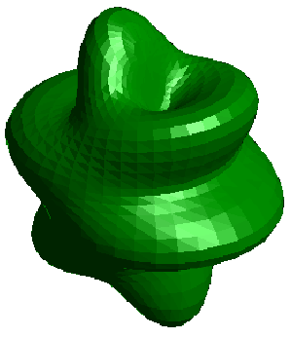
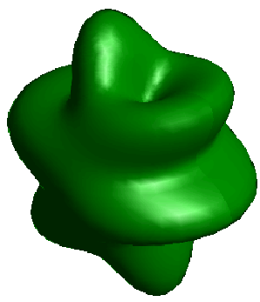
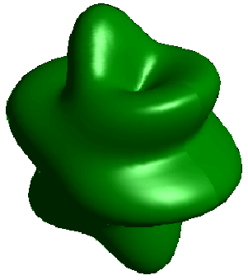
Flat shading
Gouraud shading
Phong shading

Slide 65
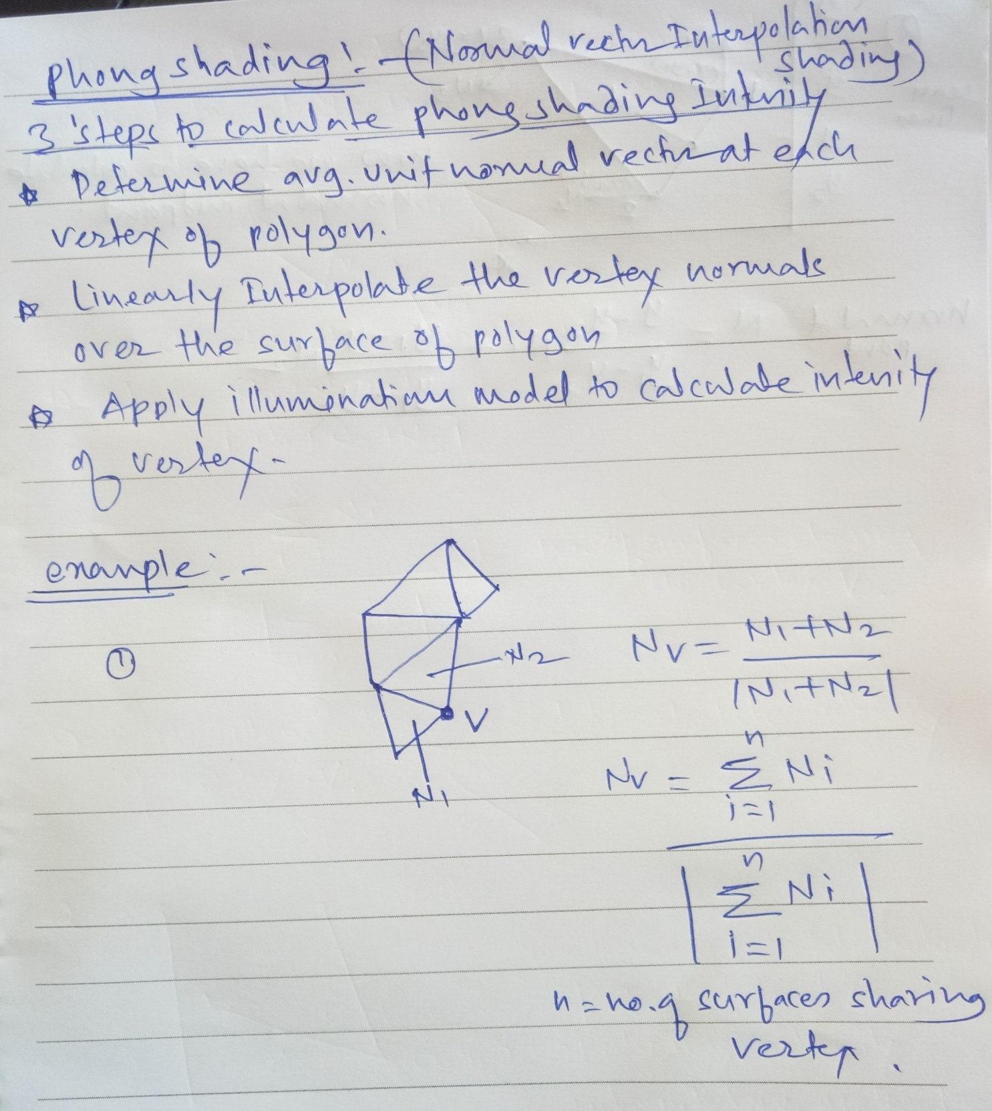

Slide 66
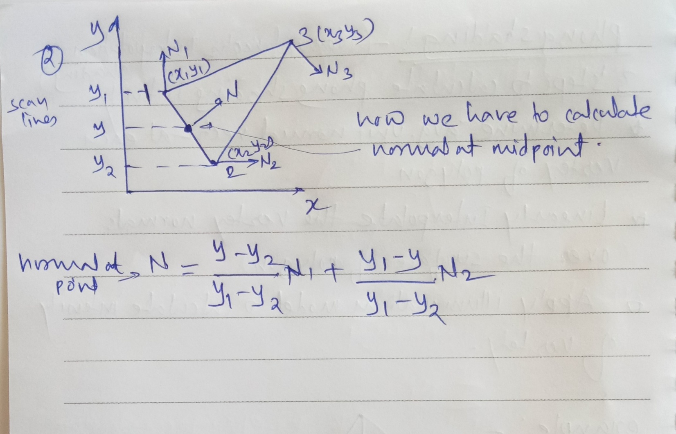

Slide 67
Comparision
Flat shading
The simplest shading method
Difference of two shading models
Phong shading is more accurate way of shading a polygon since the illumination model is applied to every point
More computationally intensive than the Gouraud
Illumination model is applied more often
Interpolated normals need to be normalized

Slide 68
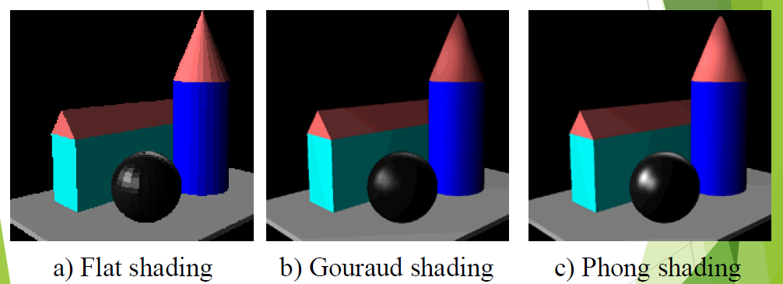

Slide 69
Ray Tracing!
In computer graphics, ray tracing is a technique for generating an image by tracing the path of light through pixels in an image plane and simulating the effects of its encounters with virtual objects.

Slide 70
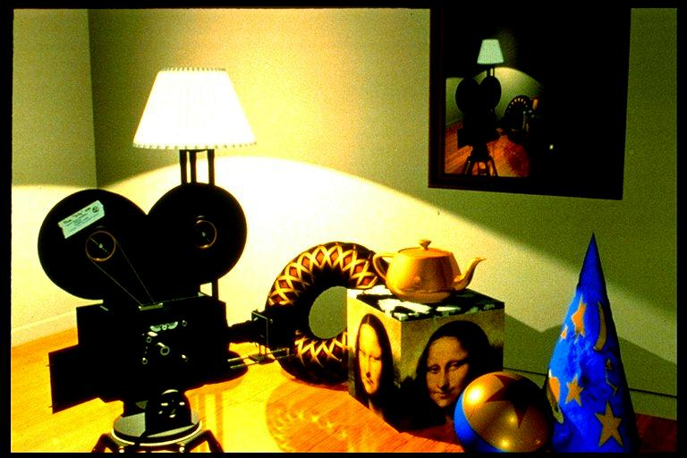
Better method, can show these realistic effects.

Slide 71
Ray Tracing Method
In computer graphics, ray tracing is a technique for generating an image by tracing the path of light through pixels in an image plane and simulating the effects of its encounters with virtual objects. The technique is capable of producing a very high degree of visual realism, usually higher than that of typical scan line rendering methods.
Ray tracing is a technique for rendering three-dimensional graphics with very complex light interactions. This means you can create pictures full of mirrors, transparent surfaces, and shadows, with stunning results.

Slide 72
basic terminology
When creating any sort of computer graphics, you must have a list of objects that you want your software to render. These objects are part of a scene or world.
so when we talk about ``looking at the world,'' we're not posing a philosophical challenge, but just referring to the ray tracer drawing the objects from a given viewpoint.
In graphics, this viewpoint is called the eye or camera. Following this camera analogy, just like a camera needs film onto which the scene is projected and recorded, in graphics we have a view window on which we draw the scene.
.

Slide 73
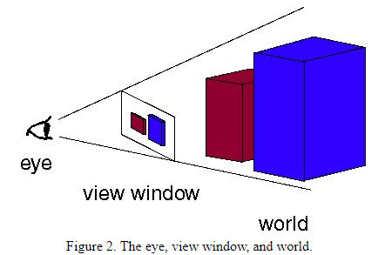
The difference is that while in cameras the film is placed behind the aperture or focal point, in graphics the view window is in front of the focal point.
So the color of each point on real film is caused by a light ray (actually, a group of rays) that passes through the aperture and hits the film, while in computer graphics each pixel of the final image is caused by a simulated light ray that hits the view window on its path towards the eye. The results, however, are the same.

Slide 74
our goal is find the color of each point on the view window. We subdivide the view window into small squares, where each square corresponds to one pixel in the final image.
If you want to create an image at the resolution of 640x400, you would break up the view window into a grid of 640 squares across and 400 square down. The real problem, then, is assigning a color to each square. This is what ray tracing does.

Slide 75
How it works
Ray tracing is so named because it tries to simulate the path that light rays take as they bounce around within the world - they are traced through the scene.
The objective is to determine the color of each light ray that strikes the view window before reaching the eye. A light ray can best be thought of as a single photon.
The name ``ray tracing'' is a bit misleading because the natural assumption would be that rays are traced starting at their point of origin, the light source, and towards their destination, the eye .

Slide 76
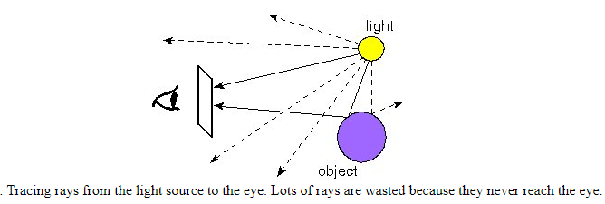

Slide 77
This would be an accurate way to do it, but unfortunately it tends to be very difficult due to the sheer numbers involved.
Consider tracing one ray in this manner through a scene with one light and one object, such as a table. We begin at the light bulb, but first need to decide how many rays to shoot out from the bulb.
Then for each ray we have to decide in what direction it is going. There is really an infinity of directions in which it can travel - how do we know which to choose?
Let's say we've answered these questions and are now tracing a number of photons.
Some will reach the eye directly, others will bounce around some and then reach the eye, and many, many more will probably never hit the eye at all. For all the rays that never reach the eye, the effort tracing them was wasted.

Slide 78
In order to save ourselves this wasted effort, we trace only those rays that are guaranteed to hit the view window and reach the eye.
After all, any given ray can bounce around the room many times before reaching the eye. However, if we look at the problem backwards, we see that it has a very simple solution.
Instead of tracing the rays starting at the light source, we trace them backwards, starting at the eye.
Consider any point on the view window whose color we're trying to determine. Its color is given by the color of the light ray that passes through that point on the view window and reaches the eye.
We can just as well follow the ray backwards by starting at the eye and passing through the point on its way out into the scene.

Slide 79
The two rays will be identical, except for their direction:
if the original ray came directly from the light source, then the backwards ray will go directly to the light source;
if the original bounced off a table first, the backwards ray will also bounce off the table.
You can see this by looking at Figure 3 again and just reversing the directions of the arrows. So the backwards method does the same thing as the original method, except it doesn't waste any effort on rays that never reach the eye.
how ray tracing works in computer graphics. For each pixel on the view window, we define a ray that extends from the eye to that point. We follow this ray out into the scene and as it bounces off of different objects. The final color of the ray (and therefore of the corresponding pixel) is given by the colors of the objects hit by the ray as it travels through the scene.

Slide 80
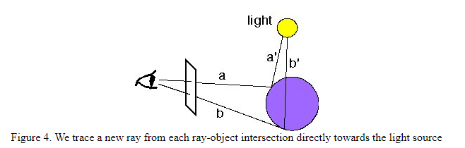
Just as in the light-source-to-eye method it might take a very large number of bounces before the ray ever hits the eye, in backwards method it might take many bounces before the ray every hits the light.
Since we need to establish some limit on the number of bounces to follow the ray on, we make the following approximation: every time a ray hits an object, we follow a single new ray from the point of intersection directly towards the light source

Slide 81
Types of Ray Tracing
Forward Ray Tracing
Forward ray tracing follows the light particles (photons) from the light source to the object.
Although forward ray tracing can most accurately determine the coloring of each object, it is highly inefficient.
This is because many rays from the light source never come through the view plane and into the eye.
Tracking every light ray from the light source down means that many rays will go to waste because they never contribute to the final image as seen from the eye.
Forward ray tracing is also known as light ray tracing and photon tracing.

Slide 82
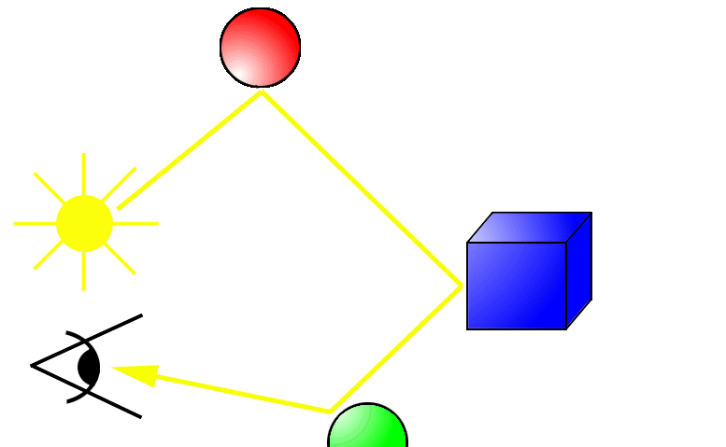

Slide 83
Backward Ray Tracing
To make ray tracing more efficient, the method of backward ray tracing is introduced.
In backward ray tracing, an eye ray is created at the eye; it passes through the view plane and on into the world.
The first object the eye ray hits is the object that will be visible from that point of the view plane.
After the ray tracer allows that light ray to bounce around, it figures out the exact coloring and shading of that point in the view plane and displays it on the corresponding pixel on the computer monitor screen.

Slide 84
Hybrid Ray Tracing:-
Since both forward ray tracing and backward ray tracing have their drawbacks, recent research tries to develop hybrid solutions that will compromise speed and accuracy.
In these hybrid solutions, only certain levels of forward ray tracing is performed.
The algorithm records the data, then goes on to perform backward ray tracing.
The final coloring of the scene takes both the backward ray tracing and the forward ray tracing calculations into account.

Slide 85
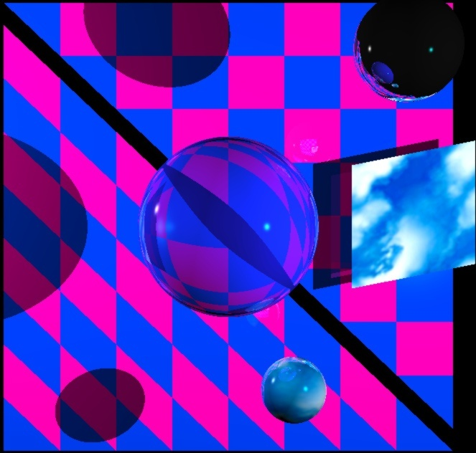

Slide 86
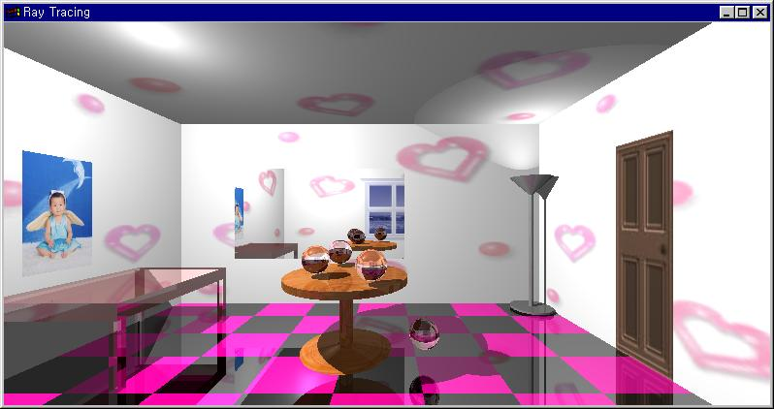

Slide 87
